Slide 1

Bitcoin PRICE PREDICTION

Slide 2
SUMMARY
Bitcoin is a cryptocurrency and worldwide payment system. It is the first decentralized digital currency, as the system works without a central bank or single administrator. It can be used to buy merchandise anonymously.
Bitcoin is highly volatile and has higher returns than conventional financial trading.
History generally has a way of repeating itself but bitcoin has a lot of history which makes it an equal challenge predicting which history will be repeated. It takes more than a study of past trends to get predictions.
The goal of this project is to find a model where we can predict the value of the Bitcoin stock considering all the factors which influence the price.

Slide 3
FACTORS THAT INFLUENCE BITCOIN
Reddit Metrics: Looking at Reddit Metrics and coin prices
Google Trends: Looking at Google searches and coin prices.
Stock Market Prices: Looking at the stock market and coin prices
Commodity Prices: Looking at Bitcoin and the more traditional stores of value (gold)
Oil Prices: Looking at Bitcoin and the oil prices
Social Media : Looking at Bitcoin and the sentiment analysis

Slide 4
DATA COLLECTION
Collected data from the following sources:
Crypto Compare - Retrieved the historical price of one coin relative to another (currency pair) from poloniex
Bitcoin Price – Retrieved basic historical information for a specific cryptocurrency from coinmarketcap.com
Google Trends - Retrieved daily google trends data for a list of search terms
Twitter data - Retrieved the historical tweets related to Bitcoin (Twitter.com)
Stock Market Prices (finance.yahoo.com)
Commodity Prices - Retrieved the historical price of gold, silver, platinum and palladium
Oil Prices - Retrieved the historical oil price (London Brent crude)
Reddit Metrics - Retrieved daily subscriber data for a specific subreddit scraped from redditmetrics.com

Slide 5
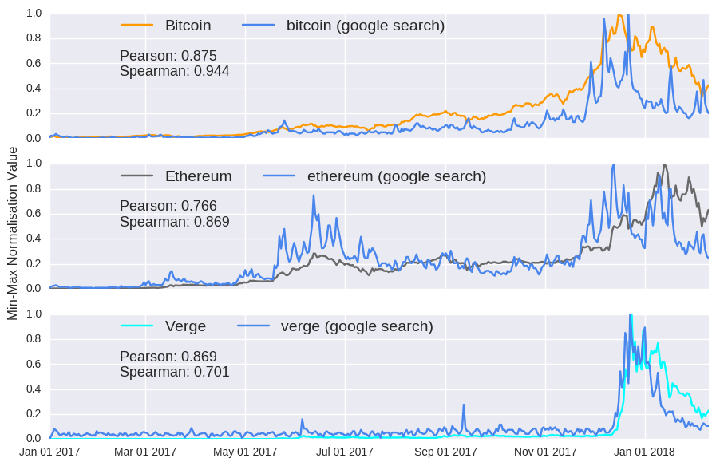
Correlation between google searches and coin prices

Slide 6
DATA PRE-PROCESSING
Reddit/Tweets
Tokenizing
Sentiment Analysis
Google Trends
Search Frequency
Merge
CoinDesk API
Bitcoin Price
Merge
Stock Market
Commodity
Oil
Stock Prices
Commodity Prices
Oil Prices
Merge
Feature Vector

Slide 7
PREDICTIVE ANALYSIS
Two types of models:
Traditional time-series ARIMA model
Deep Learning Model

Slide 8
ARIMA MODEL - PERFORMANCE
Autoregressive Integrated Moving Average – Time Series Model
With lag = 24
With difference order = 1 to make the series stationary
With moving average =1
Train/Test: 70/30
Steps | Exogeneous Variables | MSE
1 -100 | 6 | 0.000039
101-600 | 6 | 0.000918
Steps | Exogeneous Variables | MSE
1 -100 | 3 | 0.000036
101-600 | 3 | 0.000118

Slide 9
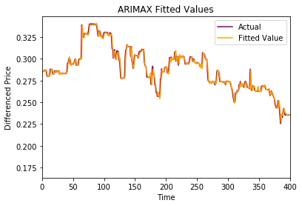
ARIMA MODEL GRAPH
ARIMA PLOTS & PERFORMANCE
Mean Squared Error : 0.000036

Slide 10
DEEP LEARNING MODEL - PERFORMANCE
Simple sequence to sequence to model
100 hidden dimension for Encoder and Decoder LSTM
KERAS and Tensor Flow
Adam Optimizer|100 Batchsize|300 epochs
Loss Function: Minimize Mean Squared Loss
RESULT
Input Sequence Length | RMSE
Lookback = 1 | 4.653
Lookback = 2 | 4.906
Lookback = 3 | 5.009

Slide 11
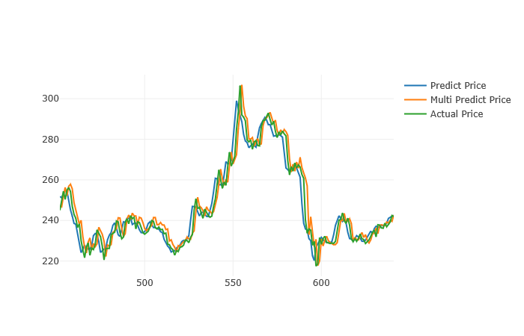
DEEP LEARNING MODEL
PREDICTION PLOTS

Slide 12
FUTURE ENHANCEMENTS
Develop an automated trading system with Buy/Sell notification
Alerts:-
Define Threshold
If Predicted Bitcoin Price is above threshold ----- ‘Buy’ signal
If Predicted Bitcoin Price is below threshold ----- ‘Sell’ signal
Alert System
SMS via Twillo
Email

Slide 13












Future Enhancement
Automated Trading System
Machine Learning Model
Data collection and pre-processing
Presentation
Bitcoin Price Chart
SMS/Email
Store results in a SQL database

